Slide 1

Survey on Optimization Techniques to Reduce Memory Footprints and Inference Time
-Anisha Aswani

Slide 2
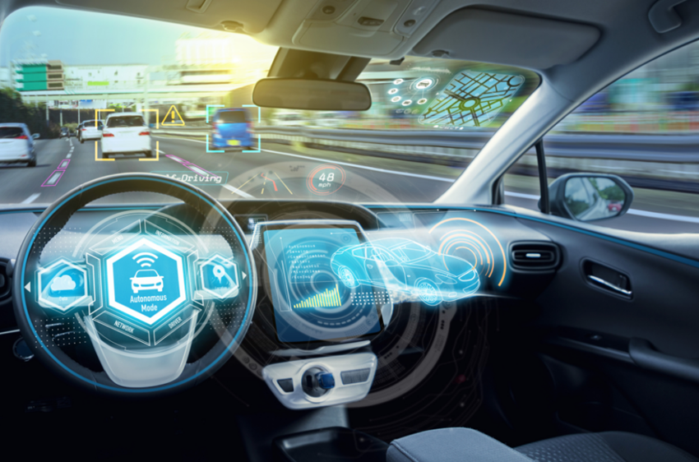

I. INTRODUCTION
Deep neural networks has shown impressive results in the field of visual recognition tasks.
Due to the large number of parameters, it puts them in disadvantage to be deployed on resource-constrained environment such as embedded systems, mobile devices, and FPGAs.
This survey is on different techniques used for compression of such DNN models so as to implement them on low storage size devices without losing output accuracy.
Autonomous Cars
Object Detection
Augmented Reality

Slide 3
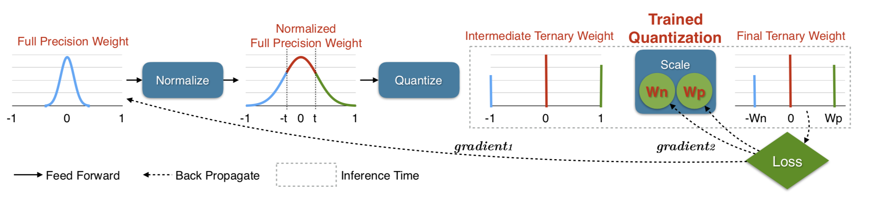
II. Trained Ternary Quantization (TTQ)
Zhu et al. proposes TTQ to reduce precision of weights to ternary values in the network.
Instead of tradition {-1, 0, +1}, the weights are quantized to {-W_{l}^{n},0,+W_{l}^{p}}, where W_{l}^{n} and W_{l}^{p} are negative and positive weights having different absolute value.
At inference time, only ternary weights are used and the full-resolution weights are discarded.
Notes:
Zhu et al. [3] propose Trained Ternary Quantization (TTQ) to reduce precision of weights to ternary values in networks. The paper highlights the quantization method which can learn both ternary values and assignments. Instead of using the traditional {-1,0,+1} or using the mean of absolute value E, {-E,0,+E}, the authors propose to quantize weights to {-W_{l}^{n},0,+W_{l}^{p}}, which uses two full-precision scaling coefficients W_{l}^{p}, W_{l}^{n} for each layer l. W_{l}^{p} and W_{l}^{n} are positive and negative weights having different absolute values which have trainable parameters. At inference time, only ternary weights are used and the full-resolution weights are discarded.

Slide 4
Result TTQ
The results on CIFAR-10 show that the accuracy obtained by ternary quantization outperforms full-precision models of ResNet-32,44,56 by 0.04%, 0.16%, 0.36% respectively.
For ImageNet, the ternary quantized model outperforms full-precision AlexNet model by 1.6%.
About 16x model compression is achieved by converting most parameters to 2-bit values.

Slide 5
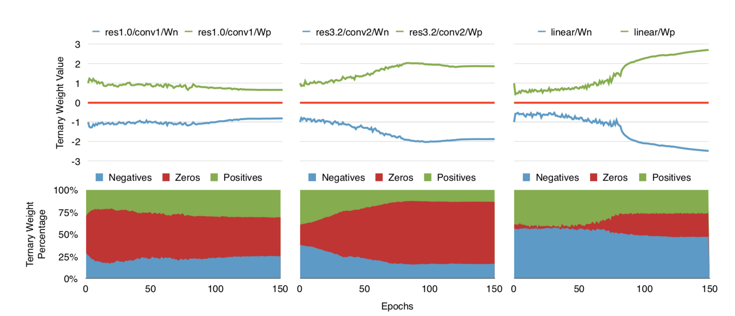
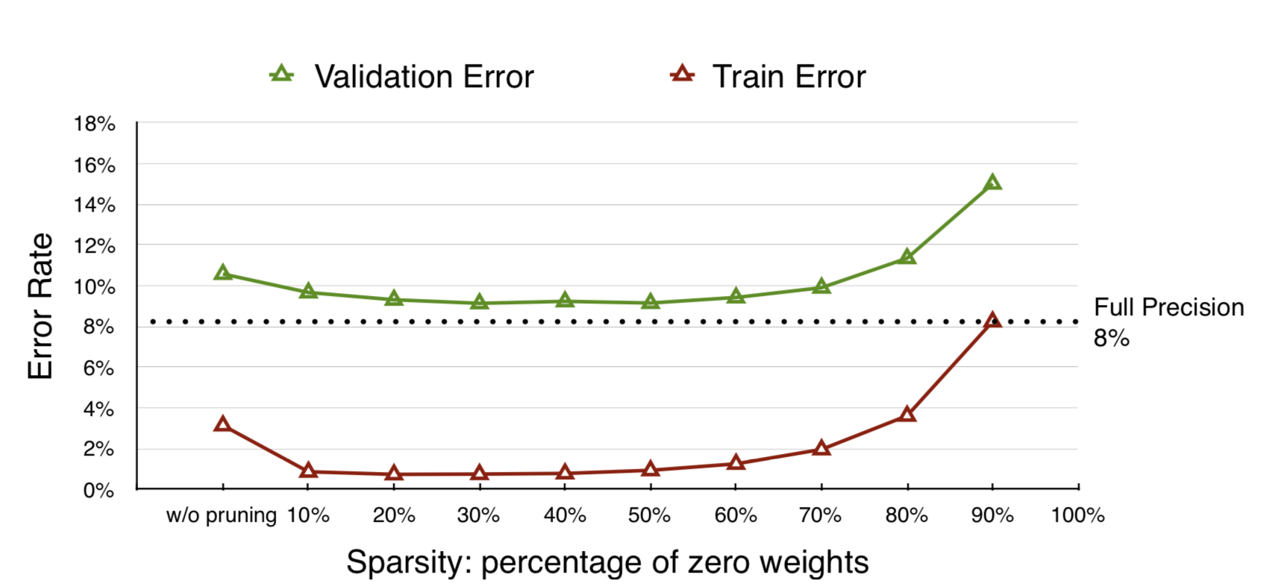
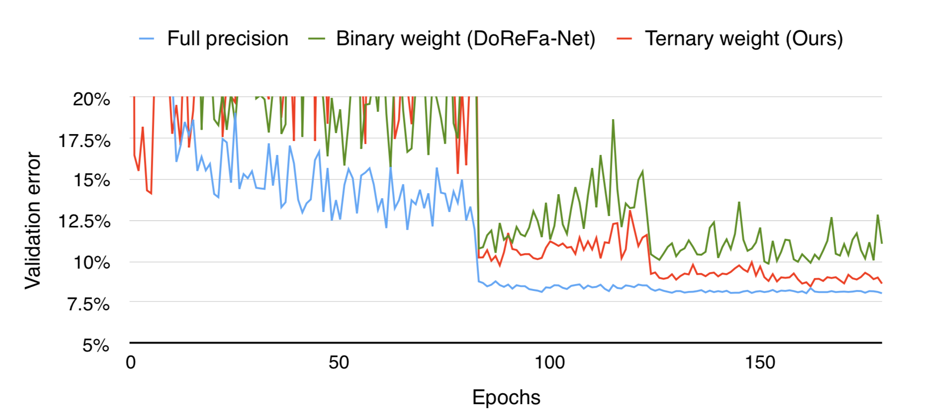
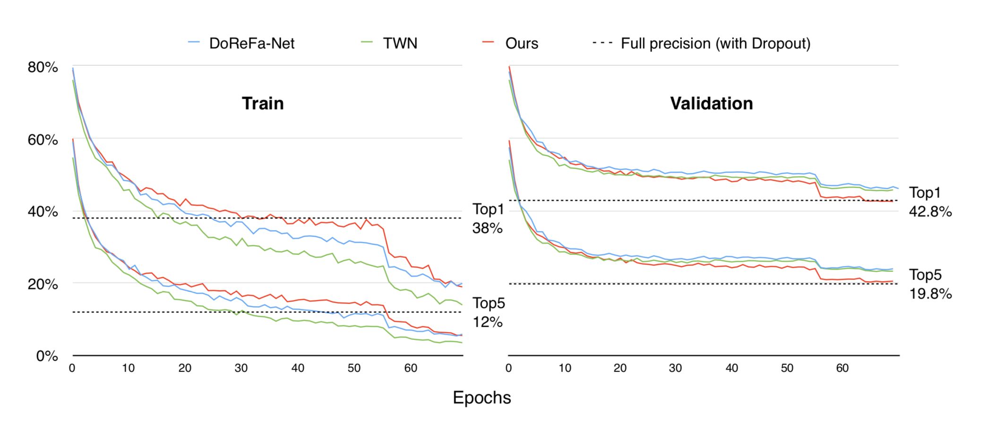
Results for TTQ
Ternary weights value (above) and distribution (below) with iterations for different layers of ResNet-20 on CIFAR-10.
Accuracy v.s. Sparsity on ResNet-20
ResNet-20 on CIFAR-10 with different weight precision.
Training and validation accuracy of AlexNet on ImageNet

Slide 6
III. Vector Quantization
Ging et al. Propose an information theoretical vector quantization method for compressing the large number of parameters used in the neural network.
The use of matrix factorization speeds up CNN and also compresses parameters in linear models [
Vector quantization is done using binarization, k means scalar quantization, product quantization, and residual quantization.
Product quantization is found to be the most efficient as it includes local redundancy structure of the network.
Residual quantization explores the redundancies of global structures between weight vectors

Slide 7
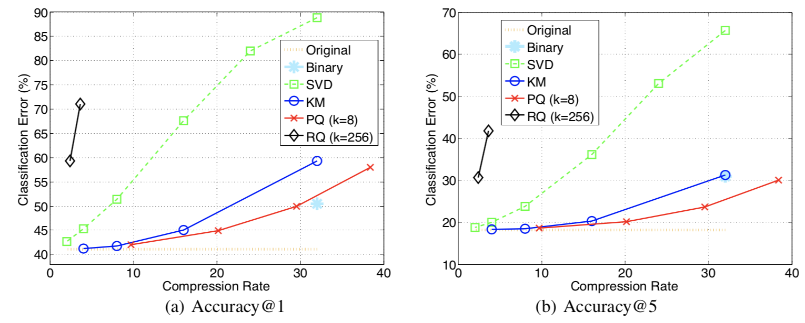
Results
Comparison of different compression methods on ILSVRC dataset
Notes:
.

Slide 8
IV. Binarization
The proximal Newton algorithm is proposed Hu et al.
It makes use of diagonal Hessian approximation which minimizes the loss corresponding to the binary weights.
This method takes into consideration the effect of binarization on the loss that occurs during binarization.
This loss is optimized using the proximal Newton algorithm with a diagonal Hessian.
This method is more robust for wide and deep networks.

Slide 9
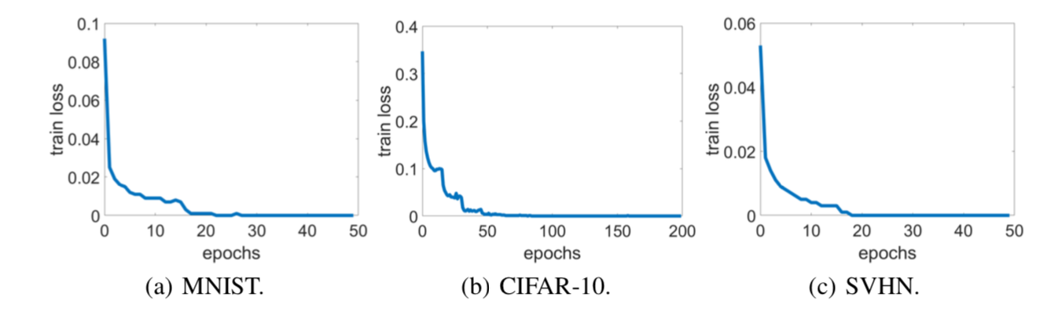
Result
The graph shows the classification error convergence of the method.
The proposed method has the lowest error on MNIST and SVHN.

Slide 10
V. Using Weights and Connection for Efficient Neural Network
Han et al. proposes an algorithm that uses a technique of learning important connections.
Three step method is used to prune redundant connections:
The important connections are found.
Unimportant connections are removed.
Network is retrained for fine tuning.

Slide 11
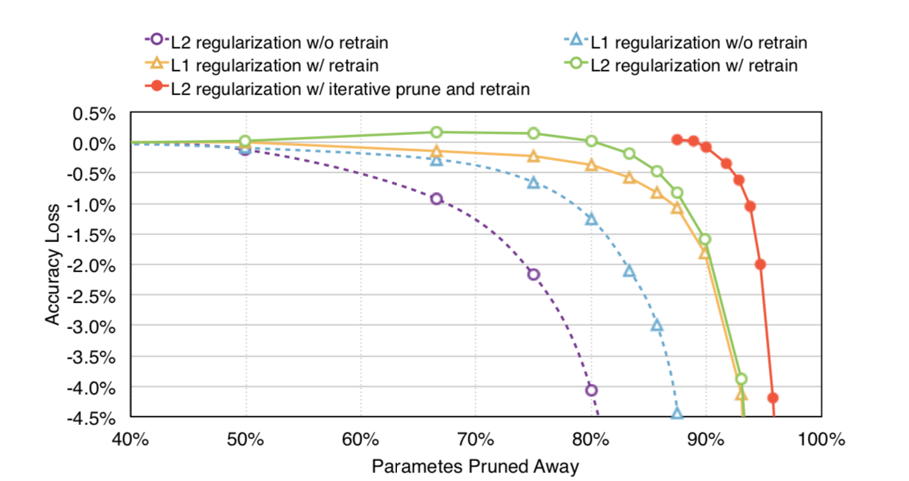
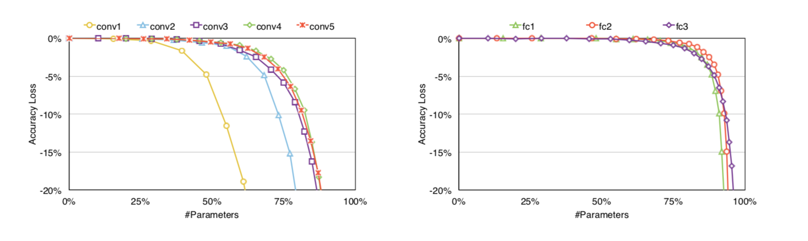
Result
Trade-off curve for parameter reduction and loss in top-5 accuracy.
Pruning sensitivity for CONV layer (left) and FC layer (right) of AlexNet.
Notes:
The network pruning was implemented in Caffe [7].The experiments were carried out on Nvidia TitanX and GTX980 GPUs.
From the graph show, L1 regularization performs better than L2 at learning the connections without retraining, while L2 regularization performs better than L1 at retraining. Iterative pruning gives the best result.
The paper shows the trade-off between the accuracy and the number of parameters. With a greater number of parameters pruned, the accuracy was found to be less. From the experiments it was observed that iterative pruning gave the best result with close to no accuracy loss. Thus, the successfully presented an algorithm to reduce memory capacity and band-width requirements, making it easier to deploy on embedded systems.

Slide 12
VI. Accelerator for Compressed DNN
This paper proposes an accelerator for sparse and weight sharing neural networks.
EIE: Efficient inference engine is proposed.
This accelerator performs customized sparse matrix vector multiplication and handles weight sharing without any loss in efficiency.
The authors proposed method takes into consideration the dynamic sparsity of activation that contributes to save computation.

Slide 13
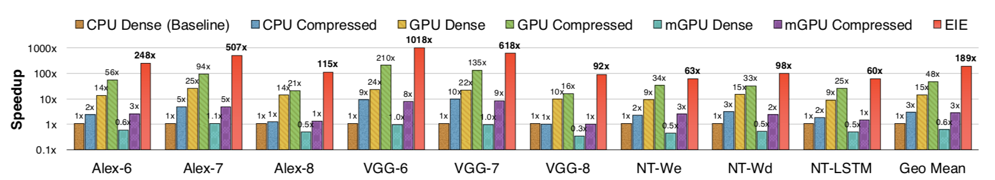
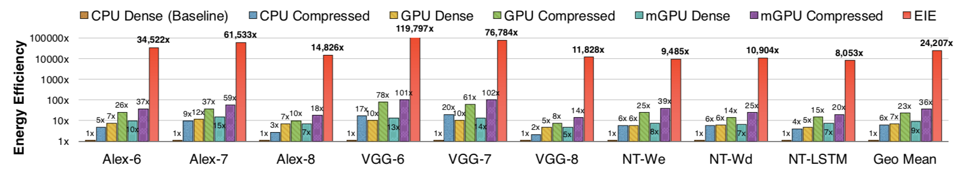
Result
Speedups of GPU, mobile GPU and EIE compared with CPU running uncompressed DNN model.
Energy efficiency of GPU, mobile GPU and EIE compared with CPU running uncompressed DNN model.

Slide 14
VII. Pruning Filters for Efficient ConvNets
Pruning is magnitude based.
Reduces a number of parameters from the fully-connected layers.
A threshold is selected, below which all the kernel weight filters are pruned.
Filters having small effect on accuracy is identified and removed.
Pruning occurs without introducing sparsity.

Slide 15
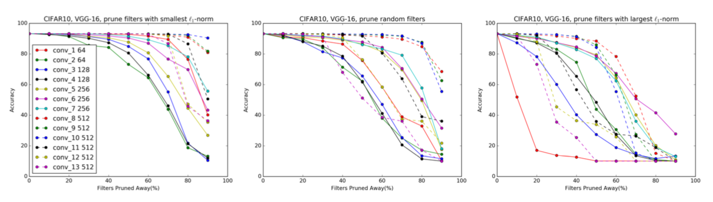
Result
Comparison of three pruning methods for VGG-16 on CIFAR-10: pruning the smallest filters, pruning random filters and pruning the largest filters. In random filter pruning, the order of filters to be pruned is randomly permuted.

Slide 16
VIII. Efficiency of Pruning for Model Compression
Zhu et al. looks into the possibility of reducing the number of parameters to be used in the network.
The pruning of network is done during training.
The weights that are important are found out and the rest unimportant weights are filtered away.
The network is trained to gradually increase the sparsity of the network while allowing the training steps to recover from any loss in accuracy due to pruning

Slide 17
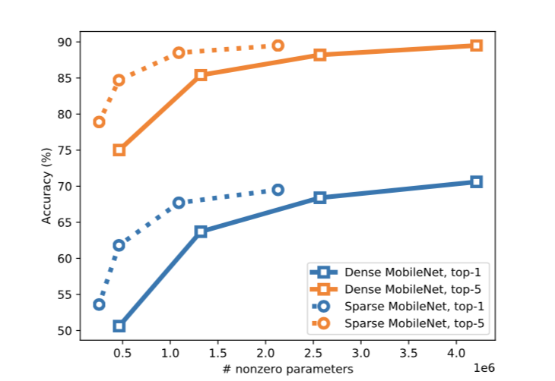
Result
This algorithm has been tested on two types of model: (1) A trained large model is pruned to obtain a sparse model which contains a smaller number of non-zero parameters; and (2) A small dense model is trained and the size of the model is similar to the large-sparse model [30]. The large-sparse model achieves higher accuracy than the small dense models. Is it observed that in pruning, the number of non-zero valued connections in the network are reduced.
Sparse vs dense results for MobileNet

Slide 18
IX. Conclusion
A survey has been successfully performed on recent techniques to compress DNNs so as to deploy them on resource-constrained environment such as embedded systems, mobile devices, and FPGAs.
There are a few challenges still faced in this domain. Most of the DNN models have limited freedom to change the configuration, thus not much change in size can be made while keeping the accuracy loss small.
Further research can be done on this topic for model compression and hardware acceleration.

Slide 19
THANK YOU

